Slide 1
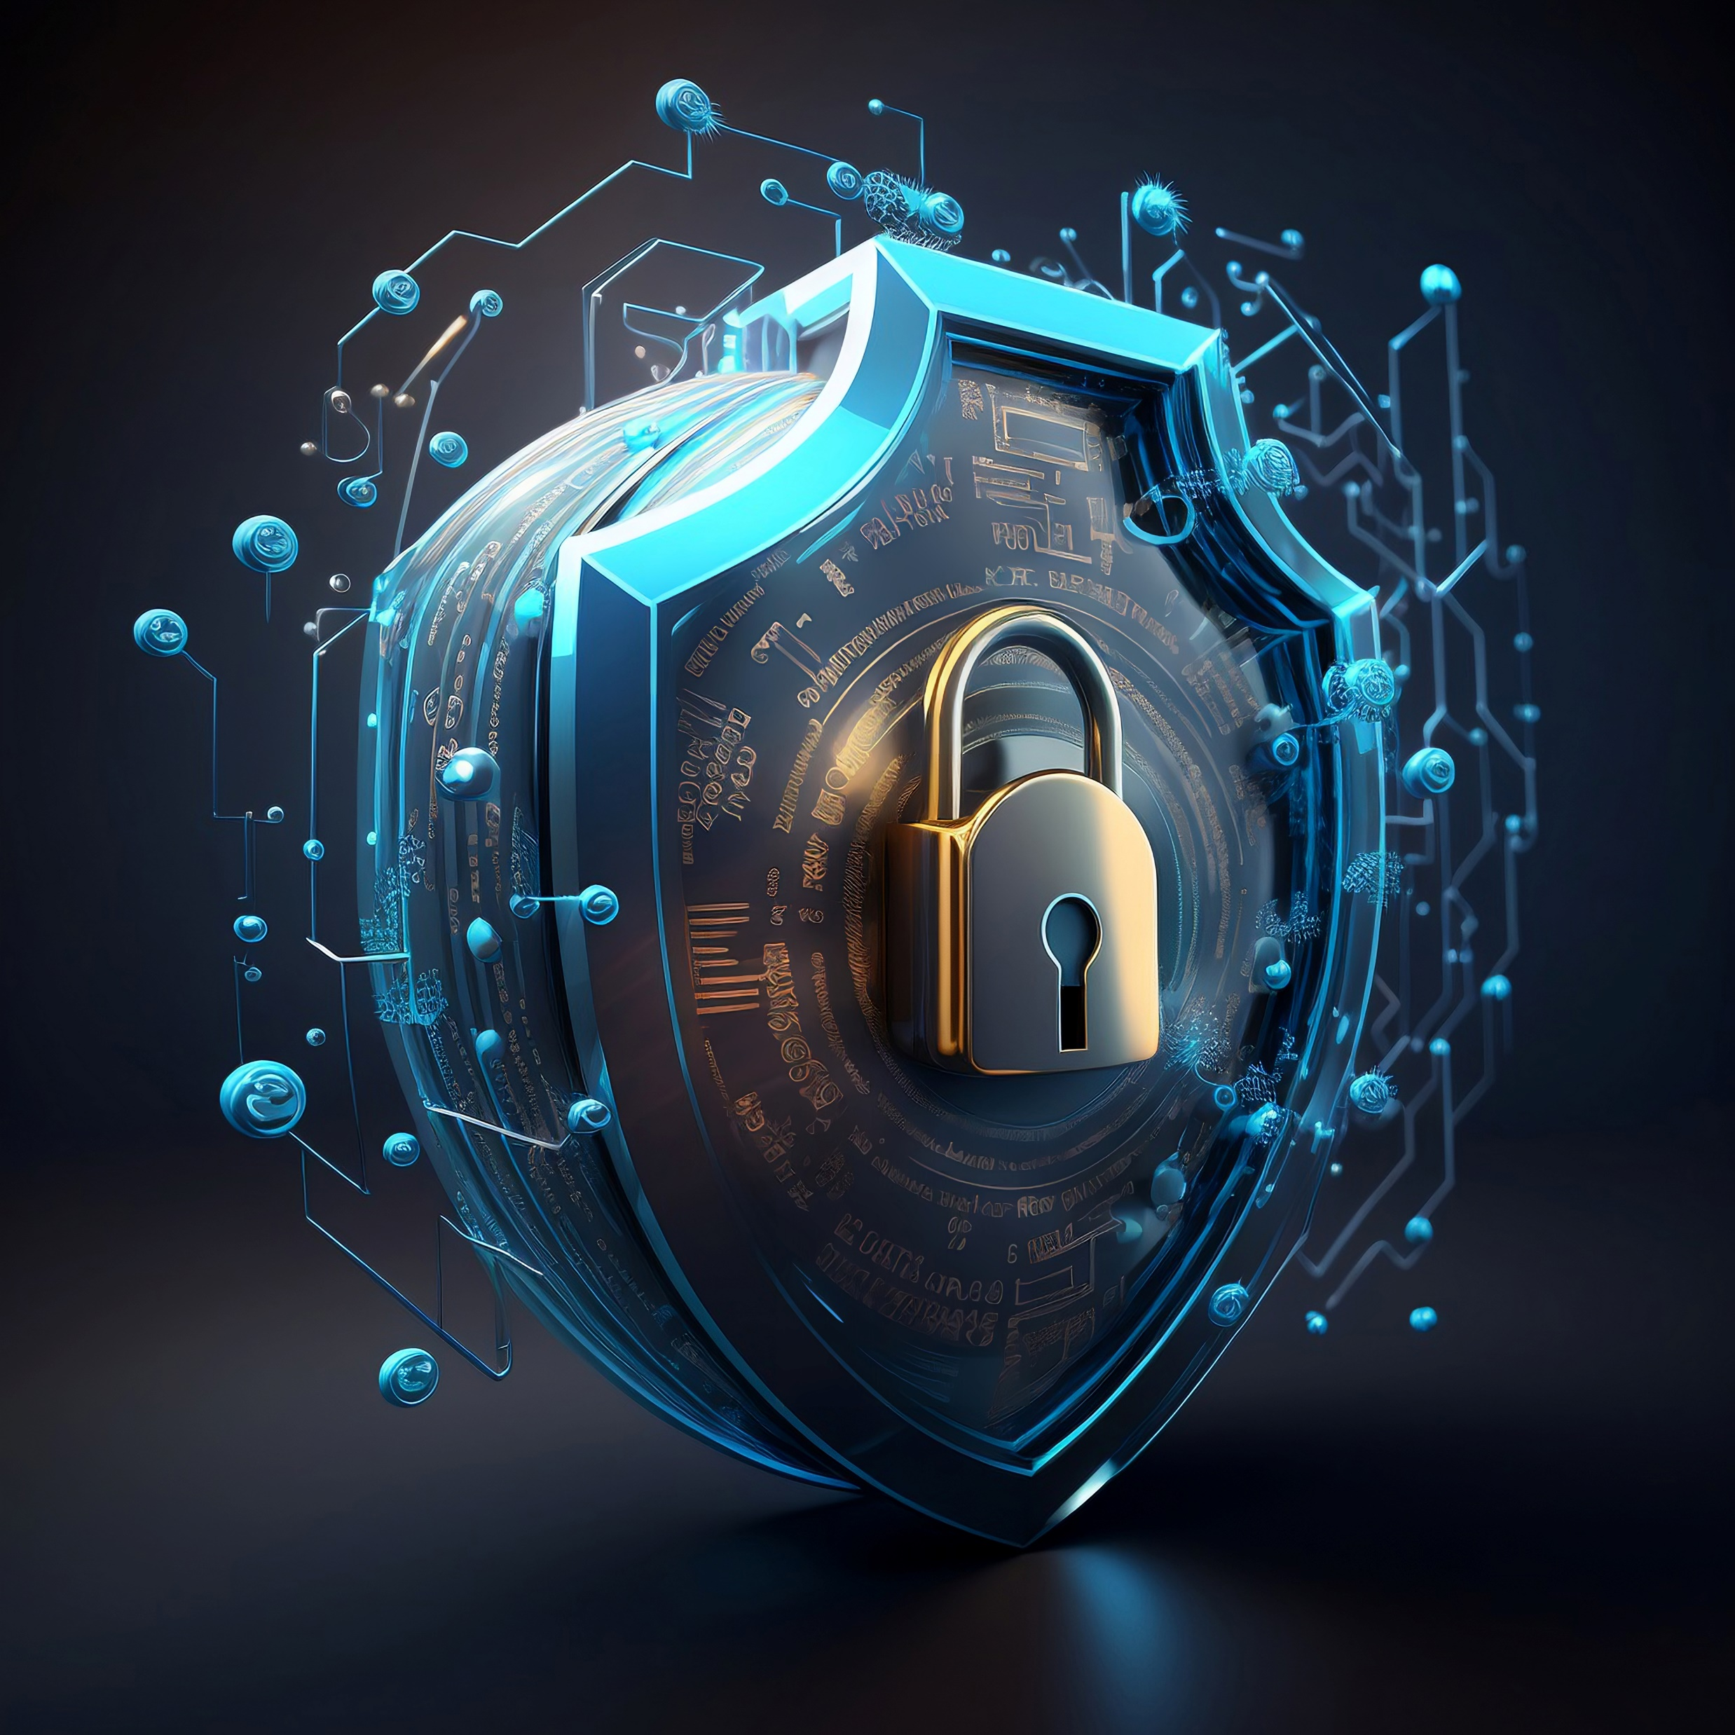
CYBERSECURITY IN THE ERA OF 5G

Slide 2
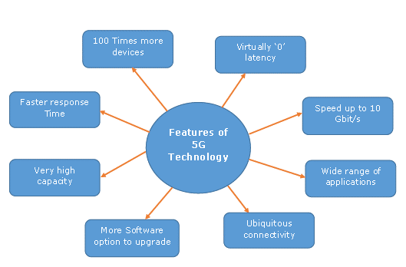
INTRODUCTION TO 5G
5G is the fifth generation of wireless technology, designed to provide faster speeds, lower latency, and increased capacity compared to previous generations. It is a revolutionary advancement that will transform the way we connect and communicate

Slide 3
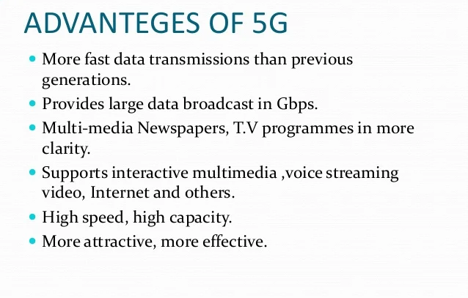

Slide 4
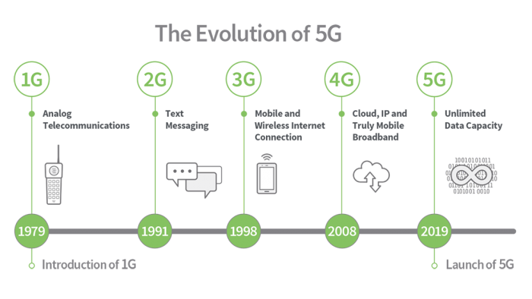

Slide 5
RISKS AND CHALLENGES
As 5G technology continues to advance, it brings with it a new set of risks and challenges for cybersecurity. The increased speed and connectivity of 5G networks create both opportunities and vulnerabilities that need to be addressed.
Risks and Challenges of 5G Technology
Increased Attack Surface - The proliferation of connected devices and the Internet of Things (IoT) increases the attack surface, providing more entry points for cybercriminals to exploit.

Slide 6
Edge Computing - The use of edge computing in 5G networks brings computation and data storage closer to the end-user, but it also increases the risk of data breaches and unauthorized access.
Supply Chain Security - The complex supply chain involved in 5G technology introduces potential security risks, as compromised components or software can be used to exploit vulnerabilities.
Privacy Concerns - The increased connectivity and data collection capabilities of 5G networks raise concerns about privacy, as personal and sensitive information may be more easily accessed or exposed.

Slide 7
SECURING 5G NETWORKS
Network Segmentation
Implement network segmentation to divide the network into smaller, isolated segments. This helps prevent unauthorized access and limits the impact of potential security breaches.
Continuous Monitoring
Implement continuous monitoring of network traffic and devices to detect and respond to potential security threats in real-time. This includes monitoring for unusual activity, unauthorized access attempts, and malware detection.

Slide 8
📡 Encryption
Implement strong encryption protocols to protect data transmitted over the 5G network. This includes encrypting sensitive information such as user data, authentication credentials, and communication between devices.
📨 Access Control
Implement strong access control measures to ensure only authorized individuals or devices can access the network. This includes using multi-factor authentication, strong passwords, and regularly reviewing and updating access privileges.

Slide 9
IMPORTANCE OF DATA PROTECTION IN THE ERA OF 5G
With the advent of 5G technology, data protection has become more crucial than ever before.
As 5G networks enable faster and more efficient data transfer, the volume of data being generated and transmitted is increasing exponentially. This data includes sensitive personal information, financial records, and intellectual property, making it a prime target for cybercriminals.
Data breaches can have severe consequences, including financial loss, reputational damage, and legal implications. In the era of 5G, where interconnected devices and systems are becoming the norm, the potential impact of a data breach is amplified.
Data protection measures, such as encryption, access controls, and regular security audits, are essential to mitigate the risks associated with 5G technology. Organizations must prioritize data protection and invest in robust cybersecurity strategies to ensure the confidentiality, integrity, and availability of their data.

Slide 10
SECURITY SOLUTIONS
Encryption
Encryption solutions protect data by converting it into an unreadable format, ensuring that only authorized parties can access and decipher the information
Access Control
Access control solutions restrict unauthorized access to sensitive data and systems by implementing authentication and authorization mechanisms.

Slide 11
Endpoint Protection
Endpoint protection solutions safeguard devices and endpoints from cyber threats by detecting and blocking malicious activities.
Network Monitoring
Network monitoring solutions analyze network traffic to detect and prevent unauthorized access, intrusions, and suspicious activities.

Slide 12
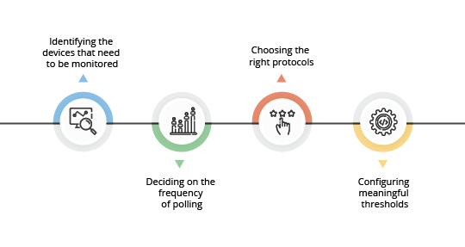

Slide 13
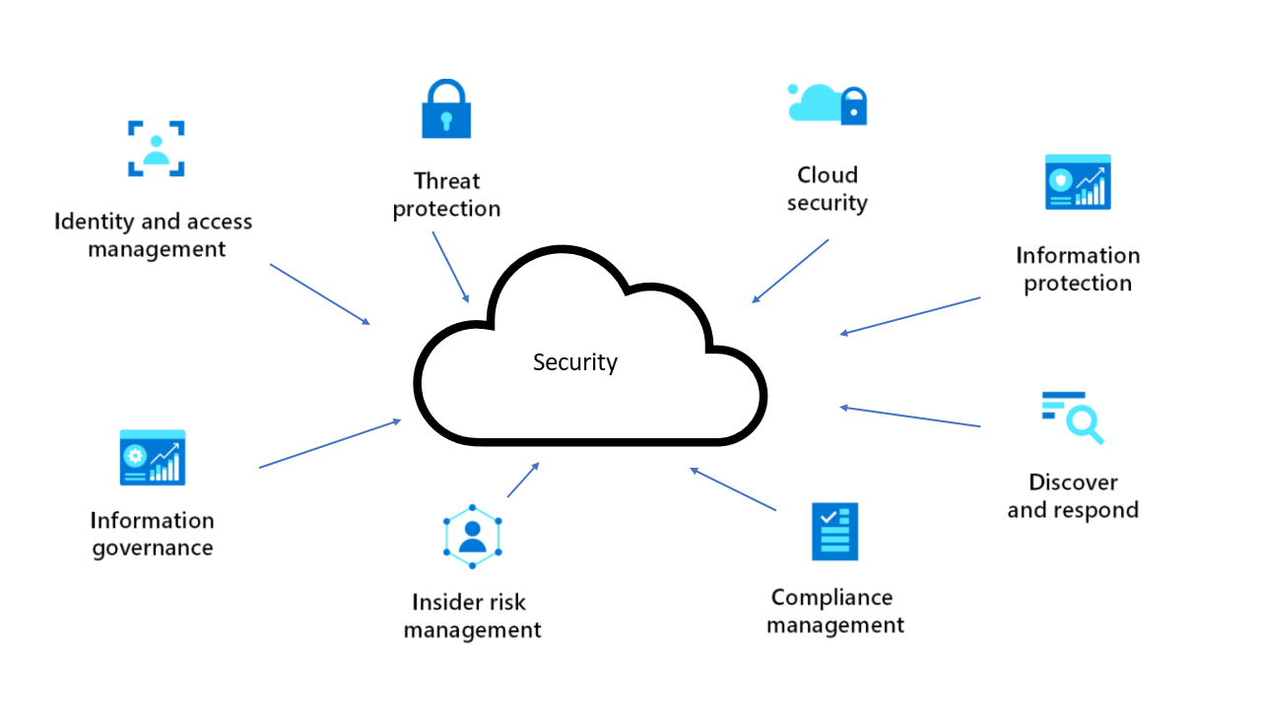
CLOUD SECURITY

Slide 14
IOT SECURITY
The Importance of IoT Security
With the rise of 5G connectivity, the Internet of Things (IoT) is becoming more prevalent in our daily lives. However, along with the benefits of IoT, there are also significant security risks. It is crucial to ensure IoT security to protect sensitive data and prevent unauthorized access.
Challenges in IoT Security
The rapid growth of IoT devices and the complexity of their interconnected networks create several challenges in ensuring IoT security. These challenges include:
Large attack surface: The increasing number of IoT devices provides more entry points for cybercriminals.
Lack of standardization: IoT devices often have different security protocols, making it challenging to implement consistent security measures.
Limited computational resources: Many IoT devices have limited processing power and memory, making it difficult to implement robust security measures.

Slide 15
Best Practices for IoT Security
To ensure IoT security in the era of 5G connectivity, it is important to follow best practices such as:
Implement strong authentication and access control mechanisms to prevent unauthorized access to IoT devices.
Encrypt data transmitted between IoT devices and backend systems to protect sensitive information.
Regularly update and patch IoT devices to address vulnerabilities and security flaws.
Monitor IoT networks for suspicious activities and implement intrusion detection systems.

Slide 16
MOBILE DEVICE SECURITY
Importance of Mobile Device Security
With the advent of 5G technology, mobile devices have become even more vulnerable to cybersecurity threats. It is crucial to implement robust security measures to protect sensitive data and ensure the privacy of users.
Mobile Device Management Solutions
Implementing a mobile device management (MDM) solution can provide centralized control and security for mobile devices in an organization. MDM solutions offer features such as remote device wiping, app management, and data encryption.

Slide 17
SOCIAL ENGINEERING ATTACKS
What are Social Engineering Attacks?
Social engineering attacks are tactics used by cybercriminals to manipulate individuals into revealing sensitive information or performing actions that compromise the security of a system or network.
Impact on Cybersecurity in the 5G Era
Social engineering attacks pose an even greater threat in the era of 5G due to the increased connectivity and reliance on digital systems. The speed and efficiency of 5G networks make it easier for cybercriminals to execute attacks and exploit vulnerabilities in the system.

Slide 18
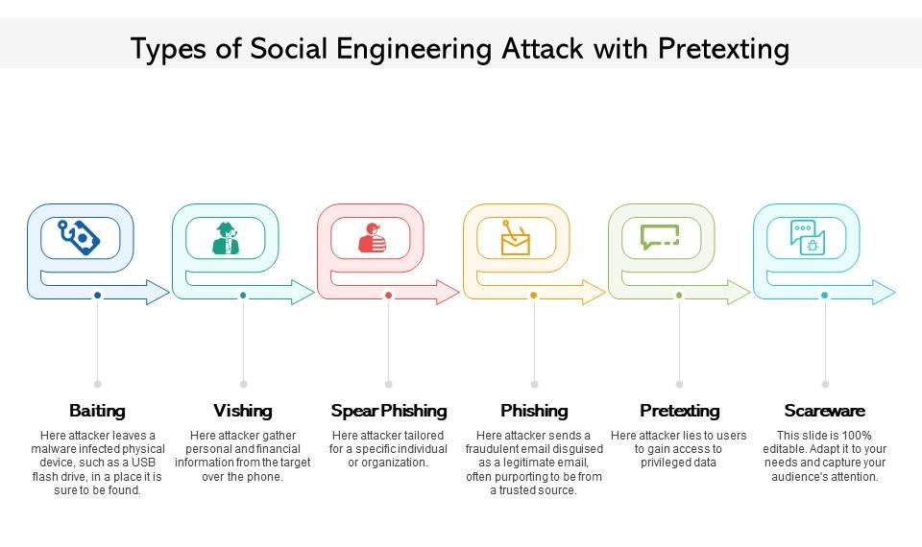

Slide 19
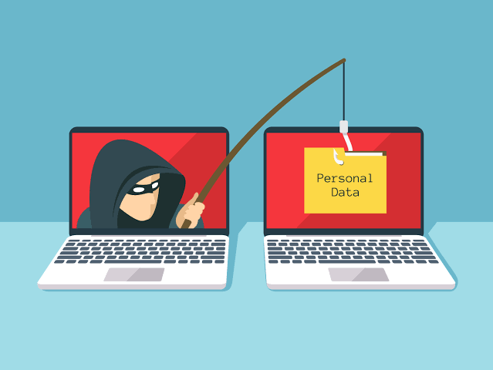
CYBER ATTACKS
Phishing: it is a type of online fraud that involves tricking people into providing sensitive information, such as passwords or credit card numbers
Malware:Malware refers to malicious software designed to disrupt, damage, or gain unauthorized access to computer systems or networks.
DDoS: distributed-denial-of-service, is a cyberattack that attempts to interrupt a server or network by flooding it with fake internet traffic, preventing user access and disrupting operations.

Slide 20
Impact on Cybersecurity
Compromise sensitive data and steal personal information.
Disrupt critical infrastructure and services, causing financial and operational damage.
Enable unauthorized access to networks, leading to further cyberattacks and data breaches.

Slide 21
CONCLUSION: IMPORTANCE OF CYBERSECURITY IN THE ERA OF 5G
In the era of 5G, cybersecurity has become more crucial than ever. With the increased connectivity and data exchange facilitated by 5G networks, the potential risks and challenges are also amplified.Cybersecurity is important to protect sensitive information, prevent unauthorized access, and ensure the integrity and privacy of data. As more devices and systems become interconnected through 5G, the attack surface for cyber threats expands, making it essential to have robust security measures in place.The potential risks of 5G include increased vulnerability to cyber attacks, as well as the potential for large-scale disruptions and breaches.

Slide 22
THANK YOU

